Slide 1
Propositional (Program) Design Logic Workshop
Andrew Hawkins ARTD Consultants

Slide 2

What is a program logic?
“Program logic is a one-page diagram that shows the important components of an intervention and how they are supposed to work together to deliver one or more intended outcomes.”
  Why do it?
  It is a tool to
    clarify and communicate what you do and expect to achieve
    frame monitoring and evaluation of a program
    identify the risks to be managed during implementation.
  It is not
    a process map
    a detailed picture of an artificially linear reality
    an attempt to describe the complete set of causal mechanisms at work in a program or describe ‘what works for whom to what effect and how’

Slide 3
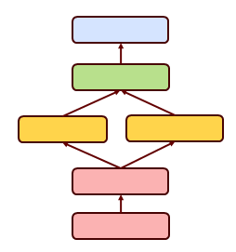
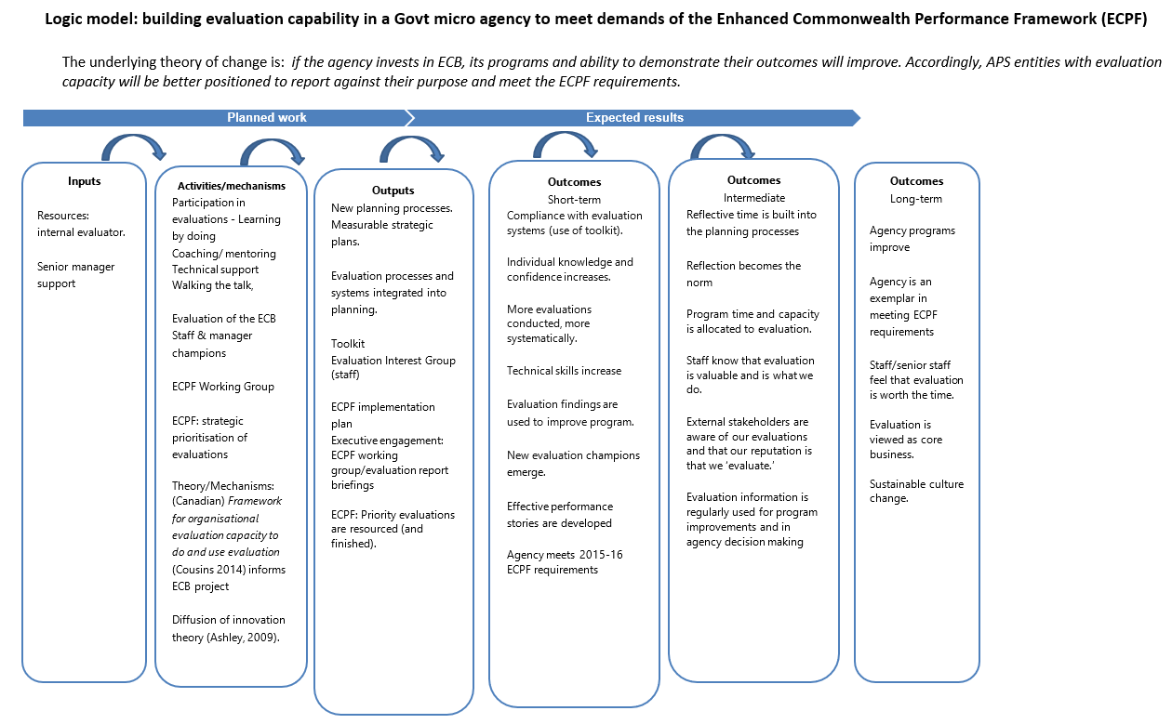
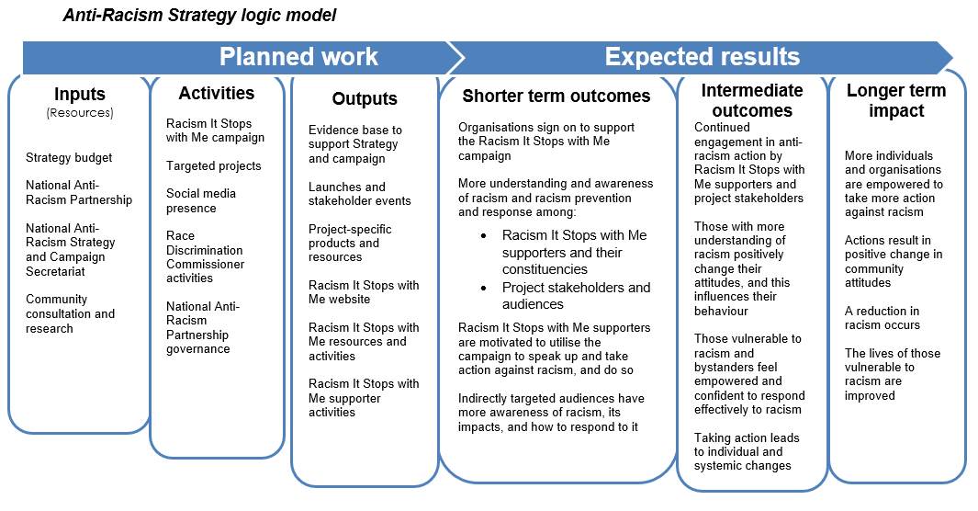
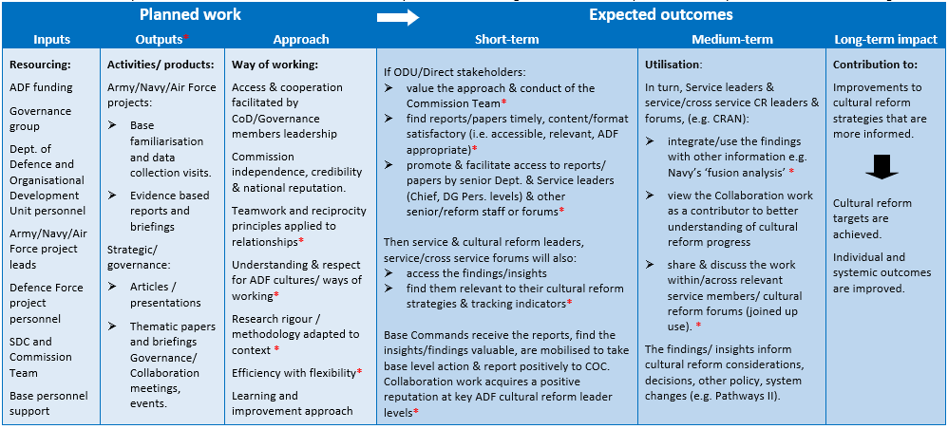
Lots of different forms of program logic

Slide 4

So what is a program?
A program at its core is simply a proposition that a certain course of action will lead to a certain set of outcomes
An evidence-based program provides good reasons to expect actions will lead to outcomes in the future
A logical evidence-based program is a proposition that makes sense ‘on paper’ & ‘in reality’
Program Design Logic (PDL) can be used to evaluate the logic or soundness of a proposition or program.
We can evaluate before, during and after a program has been delivered.
Notes:
And now I also know about the Qowat Milat, an order of Romulan warrior nuns related to the Vulcans and the ‘Way of Absolute Candor’ I am an even bigger Star Trek fan! It emphasized the total communication of emotion without filter between thought and word, resulting in the Qowat Milat being blunt and direct in conversation. The concept ran counter to everything that Romulans normally held dear.

Slide 5
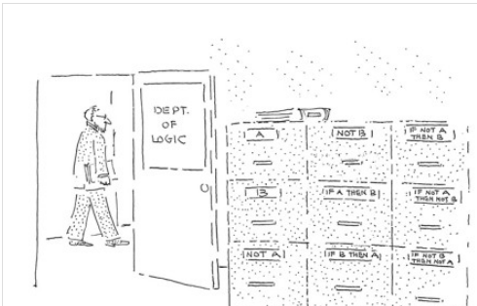
Program Design Logic (PDL)
A PDL represents the logic of a program.
The logic will be sound if it is both valid (i.e., program makes sense on paper) and well-grounded (i.e., program makes sense in reality).
  Valid if it provides good reasons to think, if we do these things these outputs will occur, and if these outputs occur these outcomes will follow.
    Reasons include; situational awareness, theories about the way the world works, past experience, and common sense.
  Well-grounded to the extent that we check after we implement the program whether we actually did these things, and whether these outputs and outcomes did actually occur.
    Most evaluations measure outcomes to see if a program is ‘well grounded’.

Slide 6
Some key terms
Inputs or activities: funds or actions necessary to implement the initiative as intended.
CONDITIONS
Outputs: conditions the initiative must create to be delivered as intended.
Outcomes: conditions that will be achieved if Outputs are delivered and Assumptions hold.
Impacts: conditions the initiative will contribute towards, also affected by External Factors.
Assumptions: conditions we are relying on, but are not 100% sure about, so we need to keep an eye on them.
External factors: conditions outside our control that we are pretty sure will also affect impacts.
Notes:
Other things can be added to a diagram as ‘accessories’. Principles, Core rationale: ‘overarching’ or ‘underpinning’ concepts, values etc relevant across the initiative can serve to communicate the logic or rationale and make it familiar to an audience.

Slide 7
Key concept
Program Design Logic is obsessed with conditions - outputs, outcomes, impacts, assumptions and external factors are all types of condition.
‘Who/what is in what condition’
Clients develop resilience
Staff have good knowledge and relationships with internal and external services their clients need
Clients engaged at site
Young people with disability participate in meaningful work experience
Staff have a clear understanding of their role

Slide 8
Example PDL

Slide 9
Simple calculation
Inputs + Assumptions = Outputs
Outputs + Assumptions = Outcomes
Outcomes + External factor = Impacts
Reasons are ‘warrants’ that support your claims about these calculations in your specific circumstance. These may be theories of change. They may be common sense.

Slide 10
Reasons
Past experience, or the results of previous evaluations are one type of reason to accept a prospective program as logical or ‘evidence based’.
Other reasons include common sense, or theories about how the world works.
You may find that some of your reasons sounded good – but turned out not to be valid or well grounded. You can update the logic with better information.
Remember
Program Design Logic is focused on the logic of the overall design – it is not focused on the how and when and for whom of each condition.
This information may or may not be of value to you. BUT don’t get confused between evaluation and research.

Slide 11
Questions to ask of a draft PDL
Is it simple without being too simple?
Have your identified all the key activities you think are necessary for it to work as intended?
  What key assumptions are you making that are outside your control, are they listed?
  Is the order of activities important, if so, is that shown on the diagram?
Have your identified external factors that will also affect the impacts so they can be considered in an outcome's evaluation?
What questions will be asked about the program?
  Does the PDL have a place for all the important things that people will want to know about i.e., does it have content that would be appear in a key evaluation question?
Does the PDL appear to cover everything that is necessary for the program to work as intended, i.e., is it sound?
  Do subject matter experts agree with the underlying logic?
  What reasons are needed to justify or warrant each step in the program logic – or suggest the program should be redesigned?
Next steps are to think about what must we know and plan an evaluation to see if the PDL is reflected in reality i.e., is it well grounded?
  How would we know if these conditions were brought about, or assumptions held?
  What can we afford to know, and to what level of detail, and when do we need to know it?
  How would we determine what is actually necessary and what is redundant or superfluous?
Develop your evaluation strategy, plan and methods to test your PDL ‘in reality’.

Slide 12
Theory of change
The overall rationale or reasons to accept a program design logic can be provided in the form of a narrative sometimes called a ‘theory of change’. For example:
“If we do these activities they will lead to these outputs and if we can make these assumptions they will lead to these outcomes because…”
This can be helpful for clarifying the logic, but you should be able to identify more granular reasons to accept each step in the logic – reasons we should accept that
Inputs + Assumptions = Outputs
Outputs + Assumptions = Outcomes
Outcomes + External factor = Impacts
While theories are important, like past outcomes, they are one type of reason, or source of evidence to accept a program as logical or ‘evidence based’. These may come from a literature review or from past evaluations.
These are usually too detailed to include on the logic diagram itself – but stating the least certain ones with references can be valuable.
Notes:
You might note that many so called ‘theories of change’ appear to be less like a formal ‘theory’ and more like a combination of a mission statement (activities) a vision (outcomes) and values (reasons or principles).

Slide 13
Theory of causality
PDL has an explicit theory of causality. This is 'configurational’.
A program and its logic set out a causal package rather than a chain of cause and effect.
  For example, awareness of a program does not cause enrolment in a program, but it may be a necessary precondition.
Program activities as a package must be ‘sufficient’ for an outcome and each condition must be ‘necessary’ for an efficient program.
  There is more than one way to deliver an outcome but the actions of the program must be sufficient for the outcome for it to be logical.
  Actions should be necessary for the program to be effective and not redundant, or the program is not efficient.
A program may not be sufficient for a longer term ‘impact’, but it should ‘contribute’ to it (in addition to external factors). This is because the intended impact provides the reason for the existence of the program. But…
Mistaking impacts and outcomes, or over stating the outcomes a program may logically achieve, can lead to an inefficient allocation of evaluation resources (e.g. measuring impacts that may be context specific, non-repeatable and non-generalisable).
Notes:
Very few, if any, theories of change that I have seen seem to include a theory of causality.

Slide 14
Evaluation and Research
Evaluation is about determining the value of a specific something. This may be in the past (for accountability), in the present (for learning) or in the future (for decisions about funding).
Evaluation must be sensitive to purpose and context.
Research is focused on an in-depth understanding of reality and identifying replicable causal mechanisms. It often seeks to make claims that are time and context invariant - transfactual.
We are interested in whether this proposed course of action is good and what evidence supports that claim.
Evidence is a feature of claims not of methods. So don’t over claim. And don’t use the wrong method.
We need sound propositions that are valid and well grounded. We are not seeking to develop a unified theory of how people behave in the world.

Slide 15
Design risks
Operational risks
Managing the risk of failure
Risks that mediate success i.e. whether your action will work at all.
1.
Validity
2.
Performance
3.
Assumptions
4.
Theory
5.
Logic
Risks that moderate success i.e. how much success your action will have.
6.
External factors
7.
Measurement
8.
Efficiency
9.
Value for money
10.
Aligned systems

